Slide 1
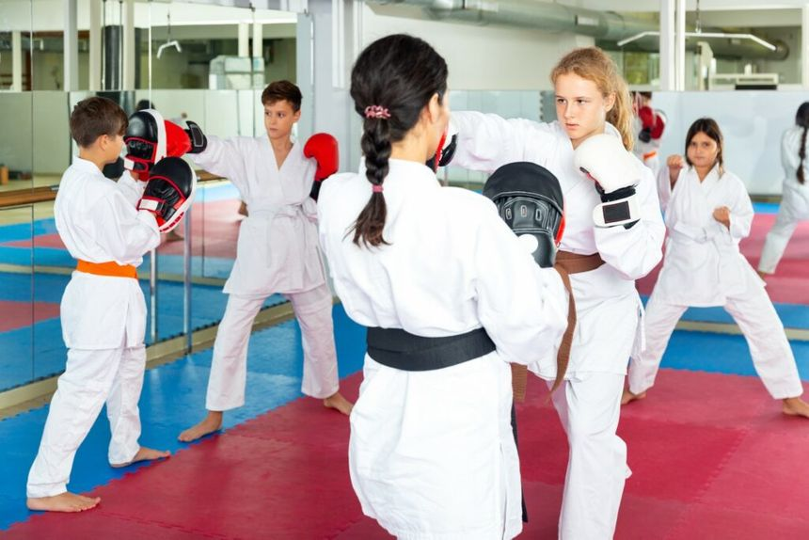
ADDING MARTIAL ARTS AS A SPORT TO SCHOOLS
Why There Is a Need
Martial Arts as a Solution
Lack of options in traditional sports clubs
People do not know self-defense
Fights often break out in schools
Add martial arts as an additional sports option in schools
Offer various martial arts (karate, taekwondo, jiu-jitsu, etc.)
Club includes both combat and technical training
What It Accomplishes
How to Implement
Would teach teenagers how to defend themselves
Martial arts provide an additional option for students not interested in typical sports
Students would learn discipline, respect, and responsibility
Martial arts would be offered the same as any other sport option
Students sign safety waivers for added risk of combat
Judges hired to referee matches, like with wrestling

Slide 2
References
Lakes, Kimberly, and William Hoyt. “Promoting Self-Regulation through School-Based Martial Arts Training.” ScienceDirect.Com, ScienceDirect, 4 June 2004, www.sciencedirect.com/science/article/abs/pii/S0193397304000309.
Moore, Brian, et al. “The Effects of a Martial Arts-Based Intervention on Secondary School Students’ Self-Efficacy: A Randomised Controlled Trial.” MDPI, Multidisciplinary Digital Publishing Institute, 10 May 2023, www.mdpi.com/2409-9287/8/3/43.

